Slide 1

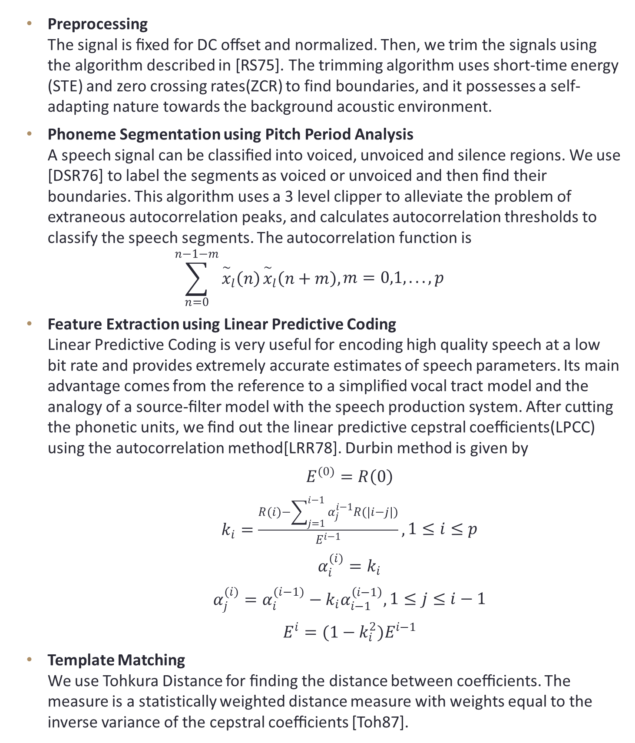
Implementation of Speech Recognition System for Mobile Devices
Abhinav Singh (140101002)
Under the guidance of Prof. Pradip K. Das
Department of Computer Science and Engineering, Indian Institute of Technology Guwahati
Introduction
Flowchart
Results
Voice centric interfaces have become widely available with the evolution of mobile phones. Advancements in speech recognition algorithms, increased computational power and net working capacities have enabled this growth.
Applications like Siri and Cortana are steadily gaining popularity with their hands free features like taking reminders and notes, opening other applications, and witty conversations. These applications can send data over to the cloud where sophisticated algorithms provide exceptionally accurate speech recognition results. In countries like India where majority of the population has no internet, these applications fail. Moreover, privacy is a big issue as these systems share the voice data with third party servers.
In this work, we implement a light weight embedded speech recognition system using phoneme segmentation, linear predictive coding and template matching. We have taken a dataset of spoken digits and the results indicate that the proposed system is able to identify the spoken digits with over 75% accuracy.
Trimming
Phoneme Segmentation
Clipping
Feature Extraction
Tohkura Distance
Template Matching
Linear Predictive Coding
Preprocessing
Voiced/Unvoiced Classification
Cepstral Coefficients
STE & ZCR Analysis
The trimming algorithm presented exceptionally good results with the accuracy as 88% if signal’s endpoints are allowed to miss by 100ms.
For many utterances, our implementation of phoneme segmentation gave erratic results. The problem was the improper choice of voiced/unvoiced threshold, hence there were few small unvoiced segments between long stretches of voiced segments.
This behavior caused a major decrease (from 77% down to 69%) in the accuracy of the system as can be seen by the tables below.
ASR accuracy (with phoneme segmentation)
Digit | 0 | 1 | 2 | 3 | 4 | 5 | 6 | 7 | 8 | 9
Accuracy | 73 | 46 | 66 | 73 | 66 | 80 | 53 | 80 | 86 | 66
Experiments
Theory
We obtained the dataset of spoken digits, 15 utterances for each person per digit, and 3 persons in total. The recordings were done in moderately quiet environments using general-purpose microphones. Graphs of trimming and phoneme segmentation are plotted below.
ASR accuracy (without phoneme segmentation)
Digit | 0 | 1 | 2 | 3 | 4 | 5 | 6 | 7 | 8 | 9
Accuracy | 62 | 80 | 86 | 64 | 95 | 77 | 73 | 73 | 86 | 82
Preprocessing The signal is ﬁxed for DC oﬀset and normalized. Then, we trim the signals using the algorithm described in [RS75]. The trimming algorithm uses short-time energy (STE) and zero crossing rates(ZCR) to find boundaries, and it possesses a self-adapting nature towards the background acoustic environment.
Phoneme Segmentation using Pitch Period Analysis A speech signal can be classiﬁed into voiced, unvoiced and silence regions. We use [DSR76] to label the segments as voiced or unvoiced and then ﬁnd their boundaries. This algorithm uses a 3 level clipper to alleviate the problem of extraneous autocorrelation peaks, and calculates autocorrelation thresholds to classify the speech segments. The autocorrelation function is
$$\sum_{n=0}^{n−1−m}{{\overset{\sim }{x}}_{l}\left(n\right)}{\overset{\sim }{x}}_{l}\left(n+m\right),\begin{aligned}m=0,1,...,p\end{aligned}$$
Feature Extraction using Linear Predictive Coding Linear Predictive Coding is very useful for encoding high quality speech at a low bit rate and provides extremely accurate estimates of speech parameters. Its main advantage comes from the reference to a simpliﬁed vocal tract model and the analogy of a source-ﬁlter model with the speech production system. After cutting the phonetic units, we ﬁnd out the linear predictive cepstral coeﬃcients(LPCC) using the autocorrelation method[LRR78]. Durbin method is given by
$E^{(0)}=R\left(0\right)$
$k_{i}=\frac{R(i)−\sum_{j=1}^{i−1}{α_{j}^{i−1}R(|i−j|)}}{E^{i−1}},\begin{aligned}1≤i≤p\end{aligned}$
$α_{i}^{(i)}=k_{i}$
$α_{j}^{(i)}=α_{i}^{(i−1)}−k_{i}α_{i−1}^{\left(i−1\right)},\begin{aligned}1≤j≤i−1\end{aligned}$
$E^{i}=(1−k_{i}^{2})E^{i−1}$
Template Matching We use Tohkura Distance for ﬁnding the distance between coeﬃcients. The measure is a statistically weighted distance measure with weights equal to the inverse variance of the cepstral coeﬃcients [Toh87].
Conclusions
Autocorrelation based phoneme segmentation is inefficient for a real-time automatic speech recognition system. Hence, need to improve phoneme segmentation by exploring other techniques.
Our system performed unsatisfactorily for changes in accents and environments. It can be attributed to the direct use of cepstral coeﬃcients. We would like to improve template matching by using aligning techniques such as Dynamic Time Warping.
The system can be improved by proﬁling the mobile user. It is seen that a there is a one to one correspondence between users and mobiles. Hence, we can save user’s old recordings and continuously improve our system.
References
[RS75] L. R. Rabiner and M. R. Sambur. An algorithm for determining the endpoints of isolated utterances. The Bell System Technical Journal, 54(2):297–315, Feb 1975.
[DSR76] J. Dubnowski, R. Schafer, and L. Rabiner. Real-time digital hardware pitch detector. IEEE Transactions on Acoustics, Speech, and Signal Processing, 24(1):2–8, Feb 1976
[LRR78] Ronald W. Schafer Lawrence R. Rabiner. Digital Processing of Speech Signals. Prentice-Hall, 1978.
[Toh87] Y. Tohkura. A weighted cepstral distance measure for speech recognition. IEEE Transactions on Acoustics, Speech, and Signal Processing, 35(10):1414–1422, Oct 1987.

